Slide 1
Interrogating public datasets and paths to results on COVID-19 in East Africa
Mike Mwanga, Eva Akurut, Isaac E Omara, Edward Lukyamuzi, Levis Katwiire, Paul Talent, Ibra Lujumba

Slide 2
Coronavirus Virus Disease 2019 (COVID-19)
COVID-19 is caused by severe acute respiratory syndrome coronavirus 2 (SARS-CoV-2)
First Identified in December 2019 in Wuhan China and declared pandemic on 30 January 2020
Mode of Transmission : droplets, contact routes
Symptoms : Fever, dry cough, sore throat, breathing problems, headaches, lack of smell
Notes:
The disease is COVID-19, caused by a virus called SARS-CoV-2
- Identified in China, declared pandemic by WHO in January 2020
-Three known modes of transmission; droplet transmission - which occurs when respiratory droplets produced by an infected person (through coughing or sneezing) gets ingested or inhaled by individuals in close proximity. Contact transmission occurs when one touches contaminated surfaces or objects and subsequently touches nose/mouth/eyes. Aerosol transmission occurs when respiratory droplets mix into the air, forming aerosols and cause infection (https://microbenotes.com/transmission-pathogenesis-replication-of-sars-cov-2/)
-Symptoms include...among others

Slide 3
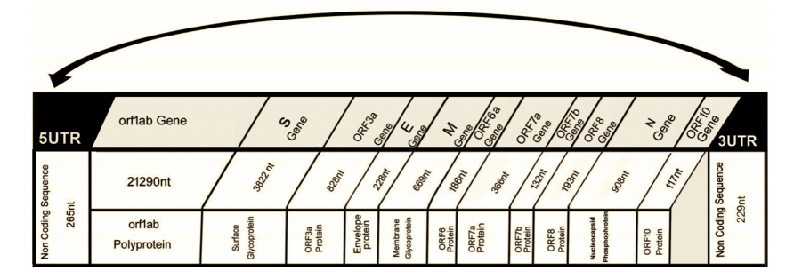
Genome structure of SARS-CoV-2
Enveloped, ssRNA(+), Non-segmented genome (~30kb)
Viral genome codes for; 16-Non-structural proteins, 4 structural proteins, 9 accessory factors
https://www.ncbi.nlm.nih.gov/pmc/articles/PMC7161481/
Notes:
SARS-CoV-2 is an enveloped, single-stranded, positive-sense RNA virus with a non-segmented genome ~30 kb in size.
The viral genome codes for 16 non-structural proteins (Nsps) required for virus replication and pathogenesis, four structural proteins, including envelope (E), membrane (M), nucleocapsid (N), and spike (S) glycoprotein important for virus subtyping and response to vaccines.

Slide 4
Problem Statement
COVID-19 has impacted us in different ways and has since december last year led to change in our lifestyles. In Order to combat this disease,unprecedented scientific efforts have been put in place so as to to understand the pathogen, SARS-CoV-2 hence obtain means to reduce its spread
Large quantities of epidemiological and bioinformatics data have been generated and are publicly available which call for a need to analyze them

Slide 5
Significance of our work
Understand the transmission patterns to help in the design of appropriate public health interventions
Insights on the genetic diversity inform testing procedures and vaccine efforts
Contribute to the knowledge base on COVID-19

Slide 6
General Objective
To undertake epidemiological and bioinformatics analysis of COVID-19 data from East Africa

Slide 7
Epidemiological analysis
Specific objectives:
To analyze infection statistics of COVID-19 in E. Africa using SEIR model
Obtain the basic reproduction ratio, R₀

Slide 8
Epidemiological analysis pipeline
Download data from the WHO
Formulate differential equations for the SEIR model
LIterature review
(parameters)
Filtered out data for Uganda and Kenya using tidyverse package
Solve differential equations using deSolve package
Obtain expression for reproductive number using SageMath 9.0
Fit model to data, obtain best-fit parameters
Preprocessing
Reproductive number
Model predictions using best-fit parameters

Slide 9
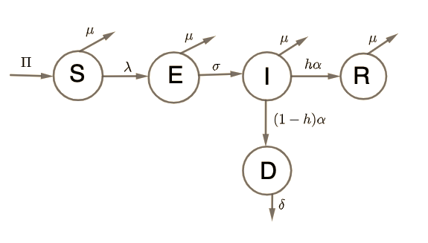
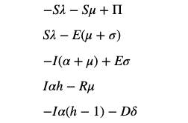
Compartmental diagram for SEIR
S(t) – susceptible, E(t) – exposed, asymptomatic, I(t) – symptomatic, R(t) – recovered, immune, D(t) - dead people
β - Effective transmission rate
𝛱 - Recruitment rate
μ -Natural death rate
𝝉 - Modification parameter for infectiousness
σ - Progression rate of exposed individuals
⍺ - Recovery rate
h -Fraction of symptomatic individuals who recovered
δ -Cremation/burial rate of deceased individuals

Slide 10
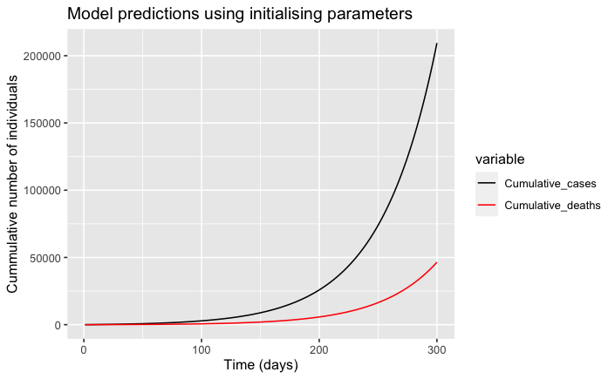
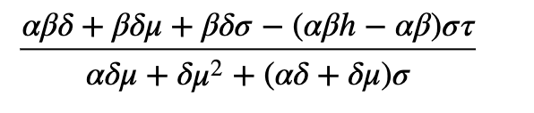
Model predictions using initialising parameters
Assumed parameters
β = 0.35, σ = 0.5, 𝛱 = 100, h = 0.65, μ = 0.00004, 𝝉 = 0.20, ⍺ = 0.33, δ = 0.5
Reproductive number

Slide 11
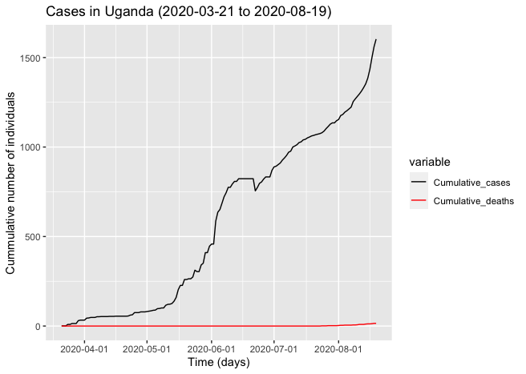
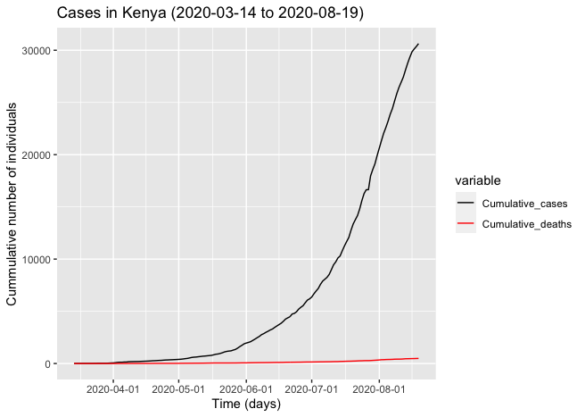
Data from WHO

Slide 12
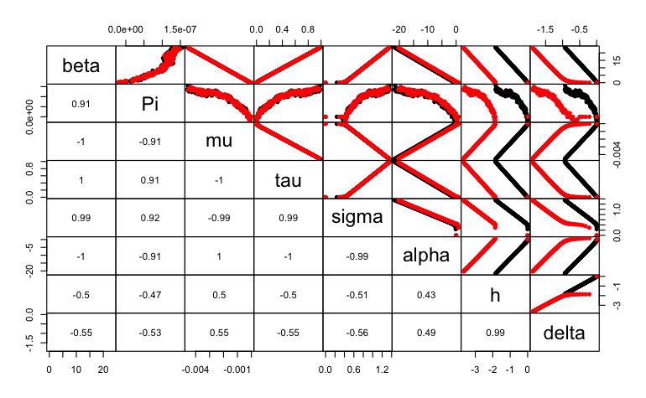
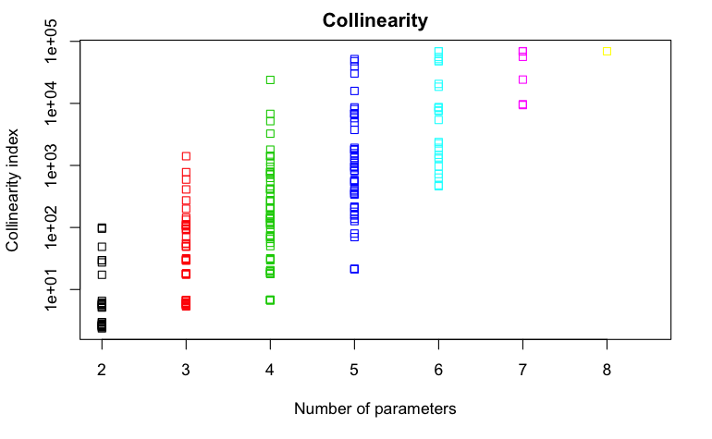
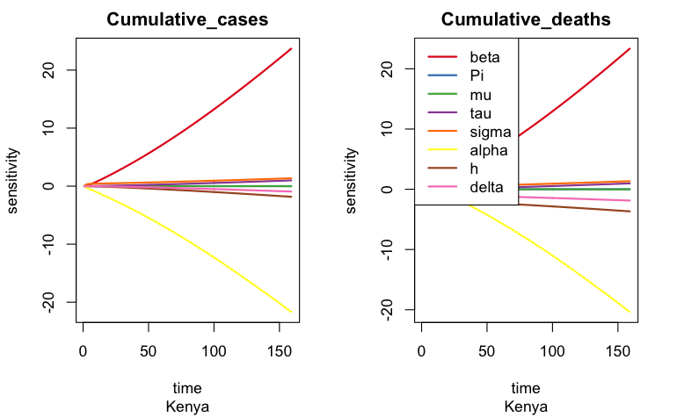
Sensitivity analysis

Slide 13
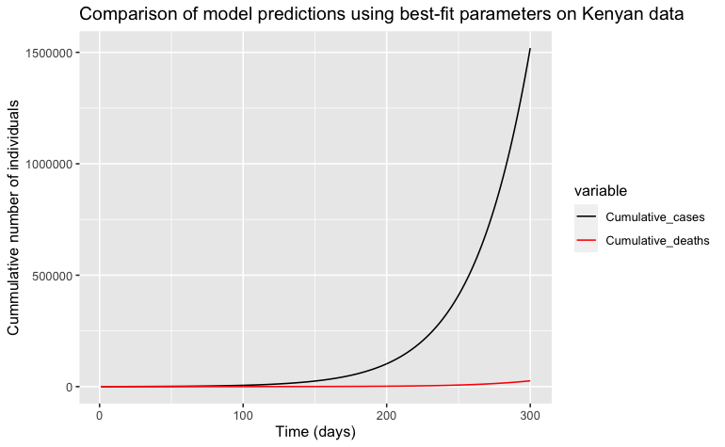
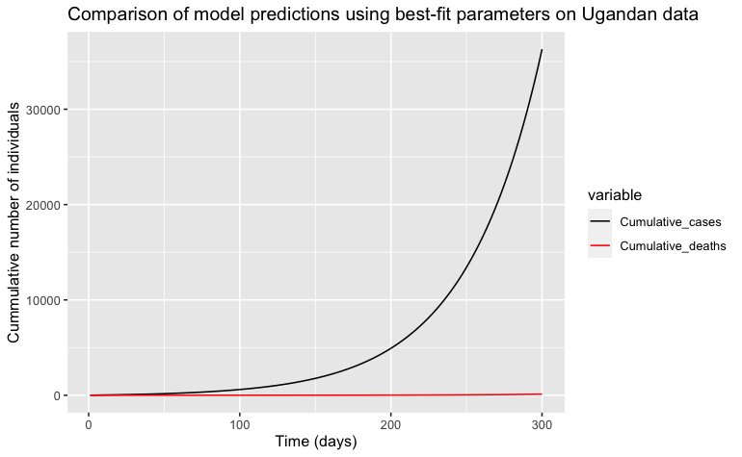
Model predictions using best-fit parameters
β = 0.539, σ = 1.295, 𝛱 = 55.948, h = 0.982, μ = 0.00004, 𝝉 = 0.20, ⍺ = 0.33, δ = 0.5
β = 0.667, σ = 0.071, 𝛱 = 353.201, h = 0.997, μ = 0.00004, 𝝉 = 0.20, ⍺ = 0.33, δ = 0.5

Slide 14
2. Specific objectives - Bioinformatics analysis
Investigate genetic diversity of SARS-CoV-2 detected in E. Africa
Estimate evolutionary rate of SARS-CoV-2 and time of most common recent ancestor (TMRCA)
Compare sequences from East Africa with global sequences and infer the source of infection and the contribution of international and local infections through time of the pandemic

Slide 15
Phylogenetics
Data Collection (GISAID Initiative)
Multiple Sequence Alignment (MAFFT)
Maximum parsimony tree
Maximum likelihood
Phylogenetic dating
TMRCA
Notes:
Complete genomes from E.A will be retrieved from GISAID/NCBI nucleotide database. Random selection and retrieval of genome sequences from Middle East (Dubai), Asia (China), Europe (UK) and America (U.S) to represent overseas cases

Slide 16
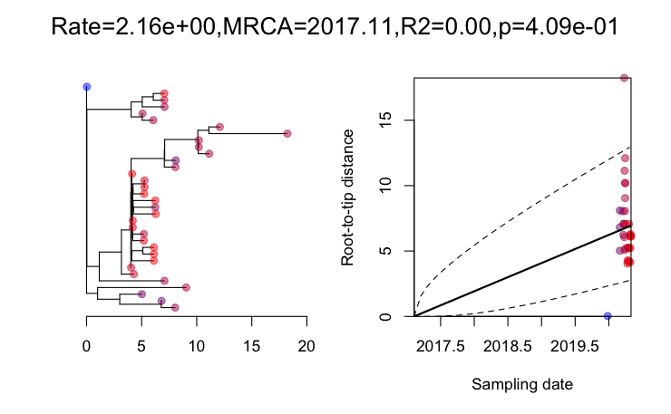
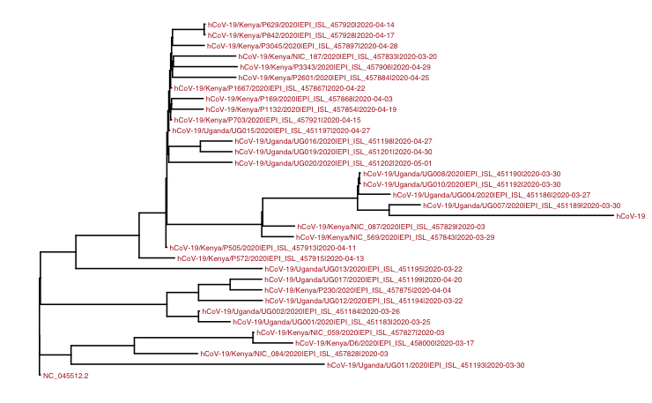
East Africa

Slide 17

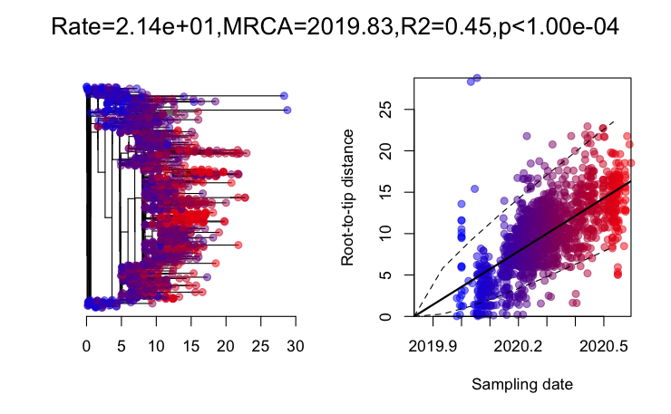
Sequences from around the world

Slide 18
Ongoing work
Tree annotation and calibration
Maximum-parsimony tree
Homoplasy detection

Slide 19
Phylogeographic analysis
Hypothesis:
Sequence evolution occurs simultaneously with geographic dispersal. Bayesian test to uncover the imprint spatial epidemiological process leave in the genomes of a fast-evolving virus
Aim:
To estimate the ancestral locations of the virus using a Bayesian discrete phylogeographic approach.
Multiple Sequence Alignment (MAFFT)
Generate BEAST XML file using BEAUTi
Run BEAST
Notes:
Complete genomes from E.A will be retrieved from GISAID/NCBI nucleotide database. Random selection and retrieval of genome sequences from Middle East (Dubai), Asia (China), Europe (UK) and America (U.S) to represent overseas cases

Slide 20
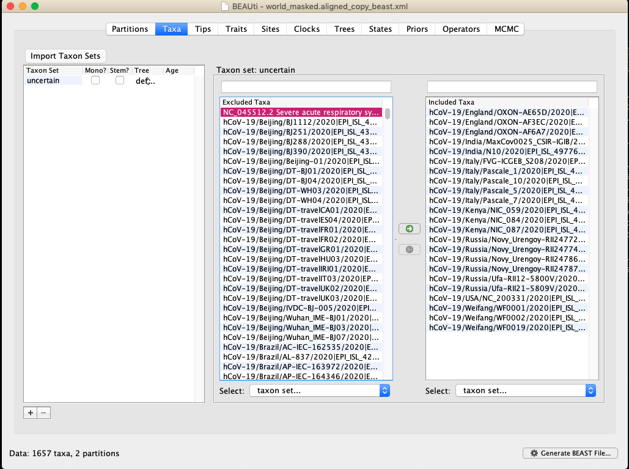
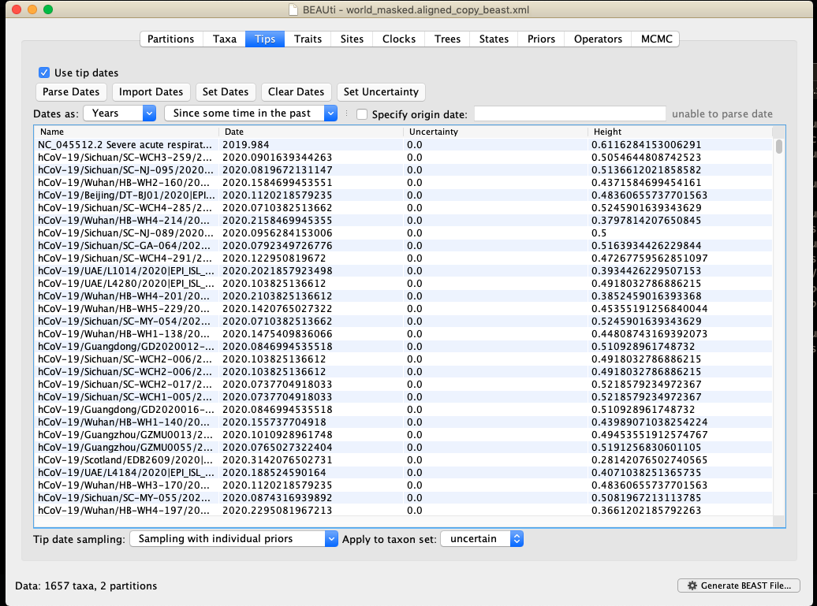
Parsing Dates

Slide 21
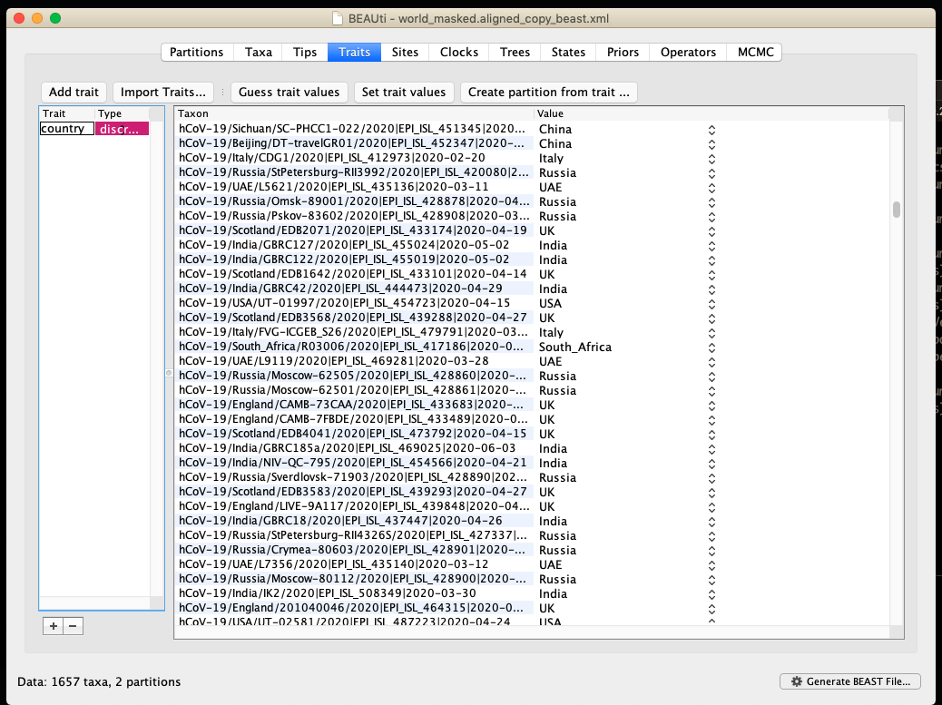
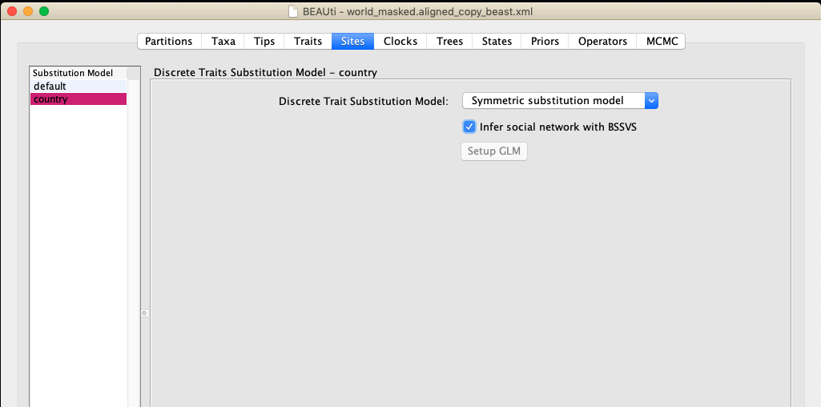
Traits and molecular clock

Slide 22
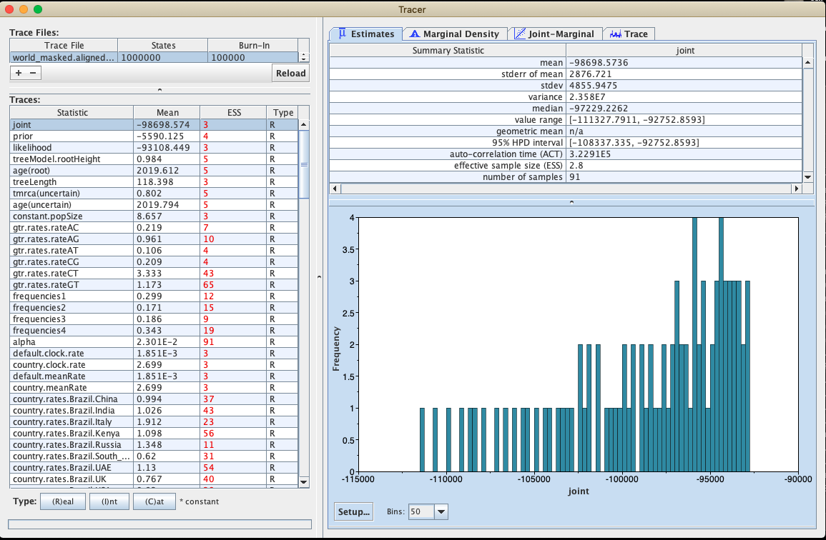
Analyzing BEAST output

Slide 23
Further steps
Rerun BEAST analysis using a longer chain
Analyse log files using Tracer
Summarizing & visualising trees using TreeAnnotator
Visualising MCC trees & calculating Bayes factor rate using SpreaD3

Slide 24
Challenges
There is no corresponding SRA data for sequence in GISAID
E. African countries without data, e.g TZ
Computational challenges
Working remotely

Slide 25
Lessons learned
Colaboration
New skills
Dedication
Planning etc

Slide 26
Acknowledgements
Labs submitting data to GISAID
EANBiT supervisors and
Dr. Lucy van Dorp
Professor Kurt Wollenberg
Group members

Slide 27
Thank you

